Slide 1

Linux
Operating Systems

Slide 2
Index
Contents
Page no.
Introduction
Architecture
Hardware support
Components and Installations
Servers Mainframes and Supercomputers
Copyright Trading and Naming
Characters of OS :
Space Management.
Memory management.
Process Management.
Network And Security.
Relations & Maintenance
4
4
6
8
8
9
10
10
11
14

Slide 3
Introduction
Linux is a family of free and open-source software operating systems built around the Linux kernel. Typically, Linux is packaged in a form known as a Linux distribution (or distro for short) for both desktop and server use.
The defining component of a Linux distribution is the Linux kernel, an operating system kernel first released on September 17, 1991, by Linus Torvalds.
Linux was originally developed for personal computers based on the Intel x86 architecture, but has since been ported to more platforms than any other operating system.Because of the dominance of the Linux kernel-based Android OS on smartphones, Linux has the largest installed base of all general-purpose operating systems.
Linux is also the leading operating system on servers and other big iron systems such as mainframe computers, and the only OS used on TOP500 supercomputers (since November 2017, having gradually eliminated all competitors).
It is used by around 2.3% of desktop computers.The Chromebook, which runs the Linux kernel-based Chrome OS, dominates the US K–12 education market and represents nearly 20% of the sub-$300 notebook sales in the US.
Linux also runs on embedded systems, i.e. devices whose operating system is typically built into the firmware and is highly tailored to the system.
This includes TiVo and similar DVR devices, network routers, facility automation controls, televisions, video game consoles and smartwatches. Many smartphones and tablet computers run Android and other Linux derivatives.
Architecture:
The Linux kernel is a monolithic kernel, supporting true preemptive multitasking (both in user mode and, since the 2.6 series, in kernel mode), virtual memory, shared libraries, demand loading, shared copy-on-write executables (via KSM), memory management, the Internet protocol suite, and threading.
Device drivers and kernel extensions run in kernel space (ring 0 in many CPU architectures), with full access to the hardware, although some exceptions run in user space, for example, filesystems based on FUSE/CUSE, and parts of UIO.
The graphics system most people use with Linux does not run within the kernel. Unlike standard monolithic kernels, device drivers are easily configured as modules, and loaded or unloaded while the system is running.

Slide 4
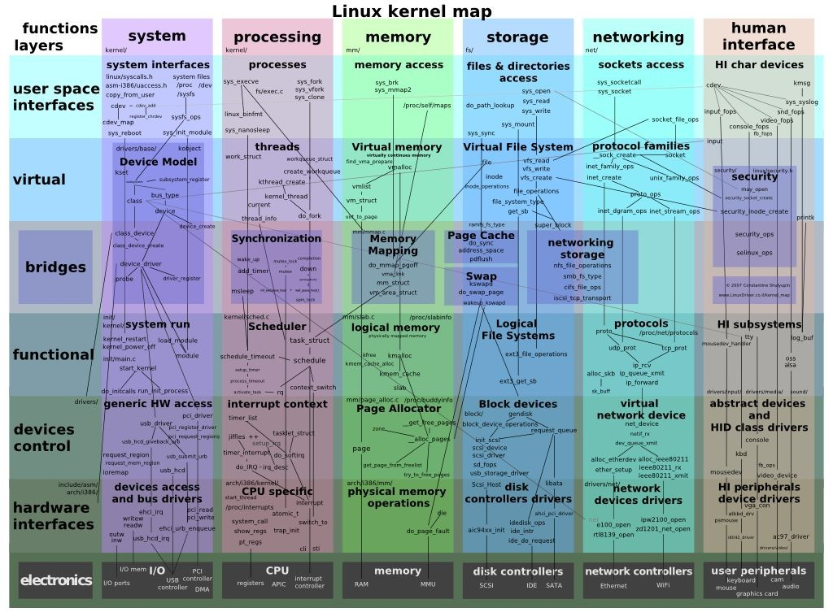
Also, unlike standard monolithic kernels, device drivers can be preempted under certain conditions; this feature was added to handle hardware interrupts correctly and to better support symmetric multiprocessing. By choice, the Linux kernel has no binary kernel interface.
The hardware is also incorporated into the file hierarchy. Device drivers interface to user applications via an entry in the /dev or /sys directories.
Process information as well is mapped to the file system through the /proc directory.
Map of the Linux kernel

Slide 5
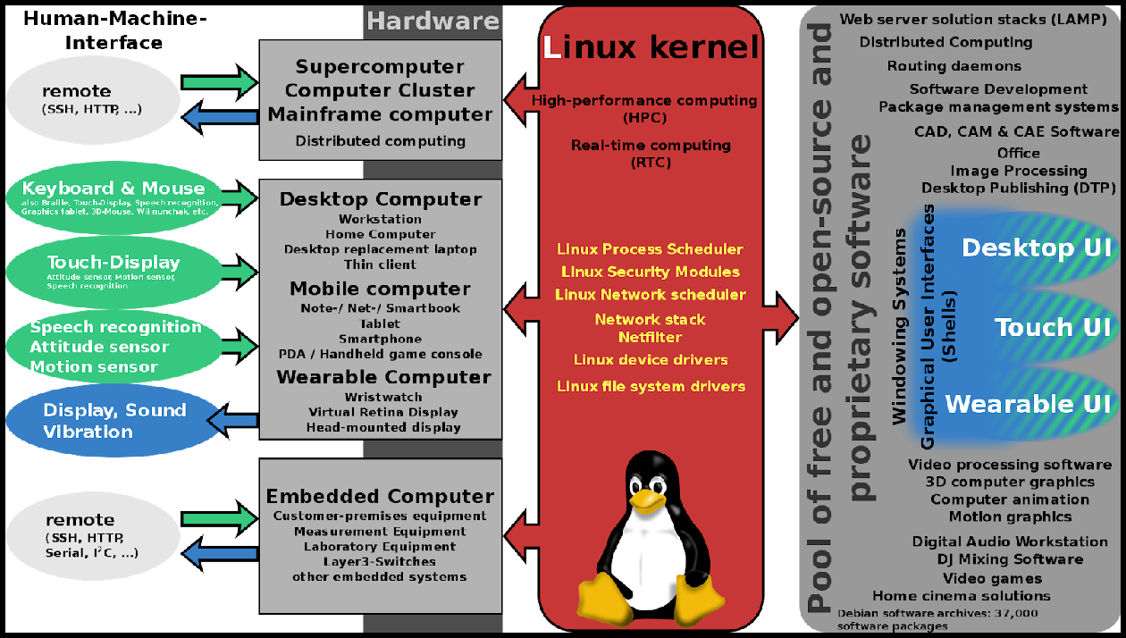
Hardware Support
The Linux kernel is a widely ported operating system kernel, available for devices ranging from mobile phones to supercomputers; it runs on a highly diverse range of computer architectures, including the hand-held ARM-based iPAQ and the IBM mainframes System z9 or System z10.
Specialized distributions and kernel forks exist for less mainstream architectures; for example, the ELKS kernel fork can run on Intel 8086 or Intel 80286 16-bit microprocessors, while the µClinux kernel fork may run on systems without a memory management unit.
The kernel also runs on architectures that were only ever intended to use a manufacturer-created operating system, such as Macintosh computers (with both PowerPC and Intel processors), PDAs, video game consoles, portable music players, and mobile phones.
There are several industry associations and hardware conferences devoted to maintaining and improving support for diverse hardware under Linux, such as Freedom HEC. Over time, support for different hardware has improved in Linux, resulting in any off-the-shelf purchase having a "good chance" of being compatible.
Linux is ubiquitously found on various types of hardware.

Slide 6
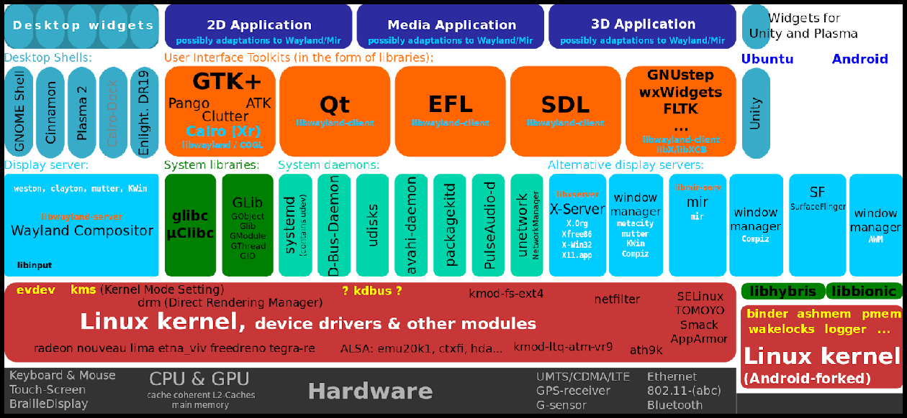
Desktop
Desktop environment and Linux adoption:
The popularity of Linux on standard desktop computers and laptops has been increasing over the years. Most modern distributions include a graphical user environment, with, as of February 2015, the two most popular environments being the KDE Plasma Desktop and Xfce.
No single official Linux desktop exists: rather desktop environments and Linux distributions select components from a pool of free and open-source software with which they construct a GUI implementing some more or less strict design guide.
GNOME, for example, has its human interface guidelines as a design guide, which gives the human–machine interface an important role, not just when doing the graphical design, but also when considering people with disabilities, and even when focusing on security.
The collaborative nature of free software development allows distributed teams to perform language localization of some Linux distributions for use in locales where localizing proprietary systems would not be cost-effective.
For example, the Sinhalese language version of the Knoppix distribution became available significantly before Microsoft translated Windows XP into Sinhalese. In this case the Lanka Linux User Group played a major part in developing the localized system by combining the knowledge of university professors, linguists, and local developers.

Slide 7
Visible software components of the Linux desktop stack include the display server, widget engines, and some of the more widespread widget toolkits. There are also components not directly visible to end users, including D-Bus and PulseAudio.
Components and installation
Besides externally visible components, such as X window managers, a non-obvious but quite central role is played by the programs hosted by freedesktop.org, such as D-Bus or PulseAudio; both major desktop environments (GNOME and KDE) include them, each offering graphical front-ends written using the corresponding toolkit (GTK+ or Qt).
A display server is another component, which for the longest time has been communicating in the X11 display server protocol with its clients; prominent software talking X11 includes the X.Org Server and Xlib.
Frustration over the cumbersome X11 core protocol, and especially over its numerous extensions, has led to the creation of a new display server protocol, Wayland.
Installing, updating and removing software in Linux is typically done through the use of package managers such as the Synaptic Package Manager, PackageKit, and Yum Extender.
While most major Linux distributions have extensive repositories, often containing tens of thousands of packages, not all the software that can run on Linux is available from the official repositories.
Servers, mainframes and supercomputers
Broad overview of the LAMP software bundle, displayed here together with Squid. A high-performance and high-availability web server solution providing security in a hostile environment.
Linux distributions have long been used as server operating systems, and have risen to prominence in that area; Netcraft reported in September 2006, that eight of the ten (other two with "unknown" OS) most reliable internet hosting companies ran Linux distributions on their web servers, with Linux in the top position.
In June 2008, Linux distributions represented five of the top ten, FreeBSD three of ten, and Microsoft two of ten; since February 2010, Linux distributions represented six of the top ten, FreeBSD three of ten, and Microsoft one of ten, with Linux in the top position.

Slide 8
Linux distributions are the cornerstone of the LAMP server-software combination (Linux, Apache, MariaDB/MySQL, Perl/PHP/Python) which has achieved popularity among developers, and which is one of the more common platforms for website hosting.
Linux distributions have become increasingly popular on mainframes, partly due to pricing and the open-source model. In December 2009, computer giant IBM reported that it would predominantly market and sell mainframe-based Enterprise Linux Server.
At LinuxCon North America 2015, IBM announced LinuxONE, a series of mainframes specifically designed to run Linux and open-source software.
Linux distributions are also dominant as operating systems for supercomputers. As of November 2017, all supercomputers on the 500 list run some variant of Linux.
Copyright, trademark, and naming
Linux kernel is licensed under the GNU General Public License (GPL), version 2. The GPL requires that anyone who distributes software based on source code under this license, must make the originating source code (and any modifications) available to the recipient under the same terms.
Other key components of a typical Linux distribution are also mainly licensed under the GPL, but they may use other licenses; many libraries use the GNU Lesser General Public License (LGPL), a more permissive variant of the GPL, and the X.Org implementation of the X Window System uses the MIT License.
Torvalds states that the Linux kernel will not move from version 2 of the GPL to version
3. He specifically dislikes some provisions in the new license which prohibit the use of the software in digital rights management.
It would also be impractical to obtain permission from all the copyright holders, who number in the thousands.
A 2001 study of Red Hat Linux 7.1 found that this distribution contained 30 million source lines of code. Using the Constructive Cost Model, the study estimated that this distribution required about eight thousand person-years of development time.
According to the study, if all this software had been developed by conventional proprietary means, it would have cost about $1.57 billion (2019 US dollars) to develop in the United States.
Most of the source code (71%) was written in the C programming language, but many other languages were used, including C++, Lisp, assembly language, Perl, Python, Fortran, and various shell scripting languages. Slightly over half of all lines of code were

Slide 9
licensed under the GPL. The Linux kernel itself was 2.4 million lines of code, or 8% of the total.
In a later study, the same analysis was performed for Debian version 4.0 (etch, which was released in 2007).
This distribution contained close to 283 million source lines of code, and the study estimated that it would have required about seventy three thousand man-years and cost US$8.66 billion (in 2019 dollars) to develop by conventional means.
SPACE MANAGEMENT
The „du“ (Disk Usage) command line is a standard command under Unix and Linux. It is used to list the disk space used by files on a machine and crucial for disk space management on unix and linux systems. Several paramaters enable users to format and filter the results.
Using du is a good starting point when trying to clean up unsed disk space under Unix.
Many smaller machines run Microsoft Windows. There is a wide range of graphical disk space managers for Windows, but few will enable you to scan Linux and Unix servers without having to resort to Samba. The Enterprise Edition of SpaceObServer will scan Unix and Linux servers via SSH.
The Memory Management:
The memory management subsystem is one of the most important parts of the operating system. Since the early days of computing, there has been a need for more memory than exists physically in a system.
Strategies have been developed to overcome this limitation and the most successful of these is virtual memory. Virtual memory makes the system appear to have more memory than it actually has by sharing it between competing processes as they need it.
Virtual memory does more than just make your computer's memory go further. The memory management subsystem provides:
1. Large Address Spaces:
The operating system makes the system appear as if it has a larger amount of memory than it actually has. The virtual memory can be many times larger than the physical memory in the system,

Slide 10
Protection:
Each process in the system has its own virtual address space. These virtual address spaces are completely separate from each other and so a process running one application cannot affect another. Also, the hardware virtual memory mechanisms allow areas of memory to be protected against writing. This protects code and data from being overwritten by rogue applications.
Memory Mapping:
Memory mapping is used to map image and data files into a processes address space. In memory mapping, the contents of a file are linked directly into the virtual address space of a process.
Fair Physical Memory Allocation:
The memory management subsystem allows each running process in the system a fair share of the physical memory of the system,
Shared Virtual Memory:
Although virtual memory allows processes to have separate (virtual) address spaces, there are times when you need processes to share memory. For example there could be several processes in the system running the bash command shell. Rather than have several copies of bash, one in each processes virtual address space, it is better to have only one copy in physical memory and all of the processes running bash share it. Dynamic libraries are another common example of executing code shared between several processes.
Shared memory can also be used as an Inter Process Communication (IPC) mechanism, with two or more processes exchanging information via memory common to all of them. Linux supports the Unix TM System V shared memory IPC.
Process Management:
Process management is a case in point. Linux creates a process whenever a program is launched, either by you or by Linux. This process is a container of information about how that program is running and what’s happening.
If the process runs and terminates correctly, then everything is hunky-dory; however, if it hogs the CPU, or refuses to go when its time is up, then the Linux commands described below may help you to restore law and order.

Slide 11
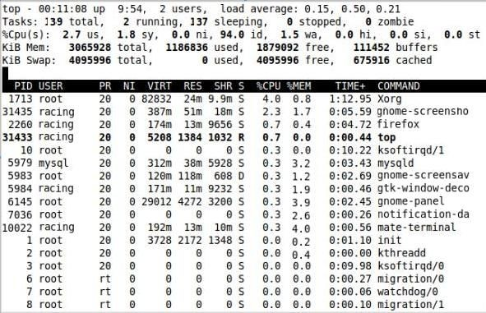
Let’s start with a list of things you may want to do when managing Linux processes:
See which processes are running
See how much of your Linux system the processes are using (especially any greedy ones)
Locate a particular process to see what it’s doing or to take action on it
Define or change the level of priority associated with that process
Terminate the process if it has outlived its usefulness or if it’s misbehaving
The commands described below should be entered via the command line interface. Simply open a terminal (all-text) window to access this interface. It may look basic, but it’s actually very powerful and flexible – just the thing for keeping all those processes in line.
1.top

Slide 12
The top command gives you information on the processes that currently exist. As the sample output above shows, the first part of the information is an overview of the situation.
The second part, organized in columns, gives details for each process, including its unique reference number (PID), priority (PR), status (S), and resource usage (%CPU, for example).
2. htop
The htop command is like top, but prettier and smarter. The information is presented in a clearer format, and you can select a particular process (use the arrow keys) and then act on it (use the F1, F2, etc. keys) with the htop display.
So why would anyone use anything other than htop? Simply because htop is not always available by default on Linux systems (whereas top is always available).
You may have an extra installation step before you can use it. Your installation instruction will be sudo apt-get install htop if you’re using Ubuntu or Debian, for instance.
The colors htop uses in its display help convey its message.
The CPU and memory bars may show blue bars for low priority processes, green for normal priority, or red for kernel. Yellow corresponds to IRQ (interrupt request) time, magenta to soft IRQ time, and gray to I/O (input/output) wait time.
The load average figure represents the degree to which the CPU is being kept busy. A figure of “1.0” corresponds to 100 percent busy. The figure of “0.37” in the screenshot below corresponds to 37 percent.
This is the load average over the last minute. The two other load average figures are the load averages over the last five and the last 15 minutes, respectively.

Slide 13
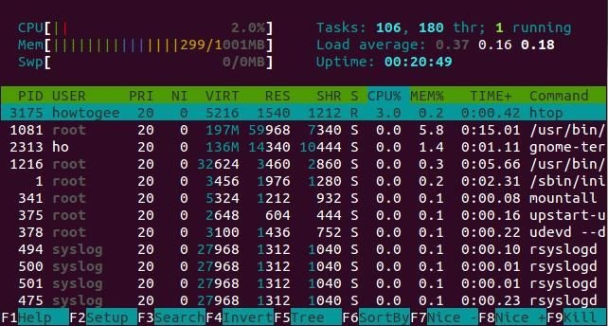
Linux Security:
Security should be one of the foremost thoughts at all stages of setting up your Linux computer. To implement a good security policy on a machine requires a good knowledge of the fundamentals of Linux as well as some of the applications and protocols that are used.
Security of Linux is a massive subject and there are many complete books on the subject. I couldn't put everything in this one tutorial, but this does give a basic introduction to security and how the techniques, and tools can be used to provide additional security on a Linux computer. Hopefully this will provide sufficient information to be able to investigate other sources of information.
Why do we need security?
Although Linux users are must less prone to viruses than some other major operating systems, there are still many security issues facing Linux users and administrators.
One of the most important steps in any task is to identify why you are doing it. Rather than just saying we need to make a system

Slide 14
secure you need to consider what is meant by secure, what risks there are associated with any data that's available, what impact your security measures will have on your users. Without first considering any of these factors how else will you know if you've met your goal of making a system secure.
Security requirements
After establishing why security is to be implemented you should consider the aspects of security that are required. The main security requirements are:
Authorisation - Only allow those that need access to the data
Authenticity - Verifying they are who they say they are
Privacy / Confidentiality - Ensure personal information is not being compromised
Integrity - Ensuring that the data has not been tampered with
Non-repudiation - Confirmation that data is received. The ability to prove it in court
Availability - Ensure that the system can perform it's required function
Imposed requirements
Some security requirements are not ones that are directly under your control but are instead imposed upon you. These may be legal requirements (e.g. Data Protection Act 1998), compliance with standards (e.g. ISO 7984-2 International Standards Organisation Security Standard), or corporate policy. If you handle credit card transactions then you may be required to comply with minimum security standards as described by the Payment Card Industry (PCI).
Some of these standards are very vague (e.g. the Data Protection Act just specifies that appropriate security should be in place) whereas some may be more specific (e.g. a corporate policy may insist on a minimum length of passwords etc.)

Slide 15
Relation with Linux distributions
Most Linux users run a kernel supplied by their Linux distribution. Some distributions ship the "vanilla" or "stable" kernels.
However, several Linux distribution vendors (such as Red Hat and Debian) maintain another set of Linux kernel branches which are integrated into their products.
These are usually updated at a slower pace compared to the "vanilla" branch, and they usually include all fixes from the relevant "stable" branch, but at the same time they can also add support for drivers or features which had not been released in the "vanilla" version the distribution vendor started basing their branch from.
Maintenance
The latest kernel version and older kernel versions are maintained separately. Most latest kernel releases were supervised by Linus Torvalds.Current versions are released by Greg Kroah-Hartman.
Maintenance of older kernel versions happens separately. Major releases as old as 2.0 (officially made obsolete with the kernel 2.2.0 release in January 1999) are maintained as needed, although at a very slow pace.
Linux kernel 4.14 has been released and with it long-term support (LTS) has been increased to 6 years, which was partially motivated by Google's desire to provide longer support for Android devices.
-0-

